Slide 1
ADAS Features

Slide 2

Agenda
01
ADAS Features
02
UI Considerations

Slide 3

01 – ADAS Features

Slide 4

ADAS Features
Cars on the Road
Overview
Definition: ADAS - Advanced Driver Assistance Systems – contains many useful features for safety and convenience
Importance: Understanding each ADAS feature is crucial to being able to develop ADAS systems
Collision Avoidance
Lane Assistance
Parking Assistance
Notes:
Some of the features listed are very broad. Let's break them down:
Collision Avoidance -
Forward Collision Warning – detects vehicles and other objects ahead of the car and warns the driver accordingly
Automatic Emergency Braking – taking action to employ the e-brake in case of an imminent collision
Adaptive Cruise Control – when cruise control is active, sensors measure the distance to the car in front. The system can modulate car speed to avoid collision with the car ahead. ACC automatically maintains a safe distance from the car ahead.
Lane Assistance – there are a few ways that ADAS can assist with lanes
Lane Departure – alerting the driver if sensors detect the car is leaving the designated lane
Lane Keeping – Furthermore, passive steering assistance ensures the car remains in lane
Blind Spot Detection – When changing lanes or turning, alerts the driver if another car is in their blind spot.
Parking – there are multiple features related to parking
When parking, sensors can detect obstacles that the car mayu crash into
Rear Cross Traffic Alert – when pulling out of a parking space, the driver can be alerted if there are oncoming cars
Rearview Camera – rearview cameras give the driver a direct view behind the vehicle, furthermore, image recognition algorithms could be used to alert the driver if an obstacle is detected in the rear-view camera.
Automated Parking Assist – while the level of automation may vary, steering and braking could be modulated to ensure the car parks smoothly and without collisions
Image: https://commons.wikimedia.org/wiki/File:Southern_Motorway_Auckland_traffic_-_copyright-free_photo_released_to_public_domain.jpg
Licensed Under: Public Domain

Slide 5
02 – UI Considerations

Slide 6
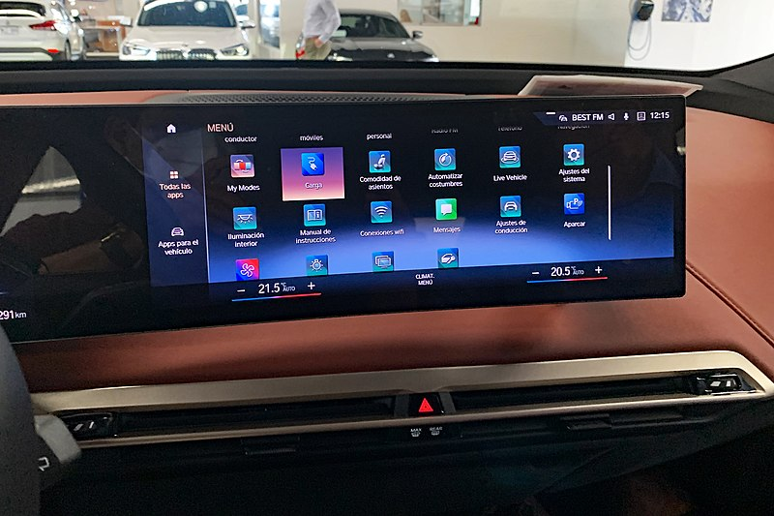
UI Considerations
Infotainment Screen
Overview
Definition: Design principles that must be considered when developing user interfaces (UI) for ADAS systems
Importance: UI for ADAS systems should be informative but not distracting to the driver
Safety
Information
Prioritization
Notes:
When designing UIs for ADAS systems, safety should be the top priority
Clear and uncluttered display – For screen displays, ensure that the design is free of clutter and is easy to read so the driver doesn't need to spend too much time looking at it
Non-intrusive alerts – using subtle indicators such as brief audio signals and minimalistic animations as opposed to loud alarms that could startle the driver and lead to accidents
Customization – That being said, including some level of customization would allow the driver to personalize their alerts based on what works best for them (within reason, you wouldn't want them to be able to completely disable alerts)
In addition to safety, the UI should be understandable and clearly convey information to the driver
Comprehension – using standardized symbols for different alerts and issues helps ensure the driver actually understands what is being conveyed
Real-Time Updates – the information that the user is seeing should be representative of what is currently going on. This point definitely ties into safety, as delays in notifications could result in delayed response times to critical events
Consistency – don't re-invent the wheel! Use existing best-practices and standards for defining common UI items (like pop-ups, alerts, tables, etc.) to promote familiarity
Prioritization – Furthermore, the information being presented should be prioritized in terms of criticality and importance
Handling multiple alerts at once – if multiple ADAS features are trying to display alerts to the user, the system must prioritize the safety-critical features. For example, if a lower priority alert is on screen when, for example, a collision is possible, the collision indicator should take precedent and replace the currently displayed alert. On the flip side, if the system is currently alerting the driver that there is a car in a blind spot, this alert shouldn't be replace by, for example, a low tire pressure indicator.
Driver Feedback – drivers should be able to dismiss warnings once acknowledged. Thus, the screen will not become cluttered with events that the driver is aware of.
Image: https://commons.wikimedia.org/wiki/File:BMW_iX_central_screen_CRI_12_2021_2732.jpg
Licensed Under https://creativecommons.org/licenses/by-sa/4.0/deed.en

Slide 7
Thank You!
Notes:
Including here a wikipedia page on ADAS: https://en.wikipedia.org/wiki/Advanced_driver-assistance_system
It includes a list of ADAS features that associates can research and report on.

